Slide 1
British Airways Customer Reviews Analysis
This report analyzes 1000 customer reviews of British Airways, collected via web scraping. The goal is to extract key insights from sentiment analysis and topic modeling to understand customer opinions.
An Overview of Sentiment and Topic Modeling Insights
Prepared by: [Ankit Shankhala]

Slide 2
Overview
1000 customer reviews analyzed
Sentiment analysis and topic modeling performed

Slide 3
Visual Insights
Sentiment Bar Chart: Distribution of positive, negative, and neutral reviews
Topic Visualization: Interactive LDA model to explore key themes
Word Cloud: Most common words in reviews

Slide 4
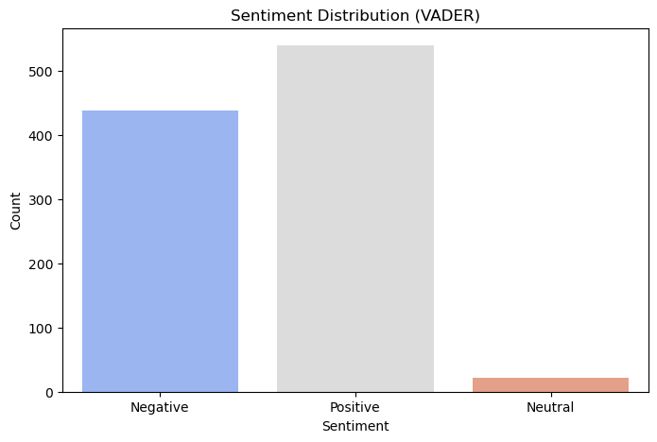
Sentiment Distribution (VADER)
Positive – 54.0%
Negative - 43.9%
Neutral -2.1%

Slide 5
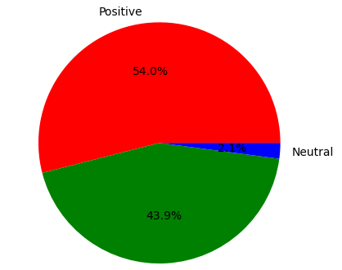
Sentiment Distribution
Positive – 54.0%
Negative - 43.9%
Neutral -2.1%

Slide 6
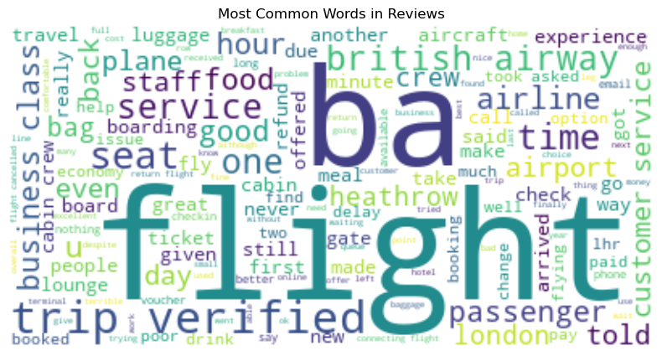
Most Common Words in Reviews

